Slide 1
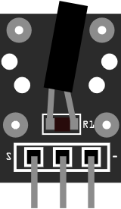
05 Tilt sensor
HDX
HDX
S1
QC
R1
R1
S
-
1 2 3

